Slide 1
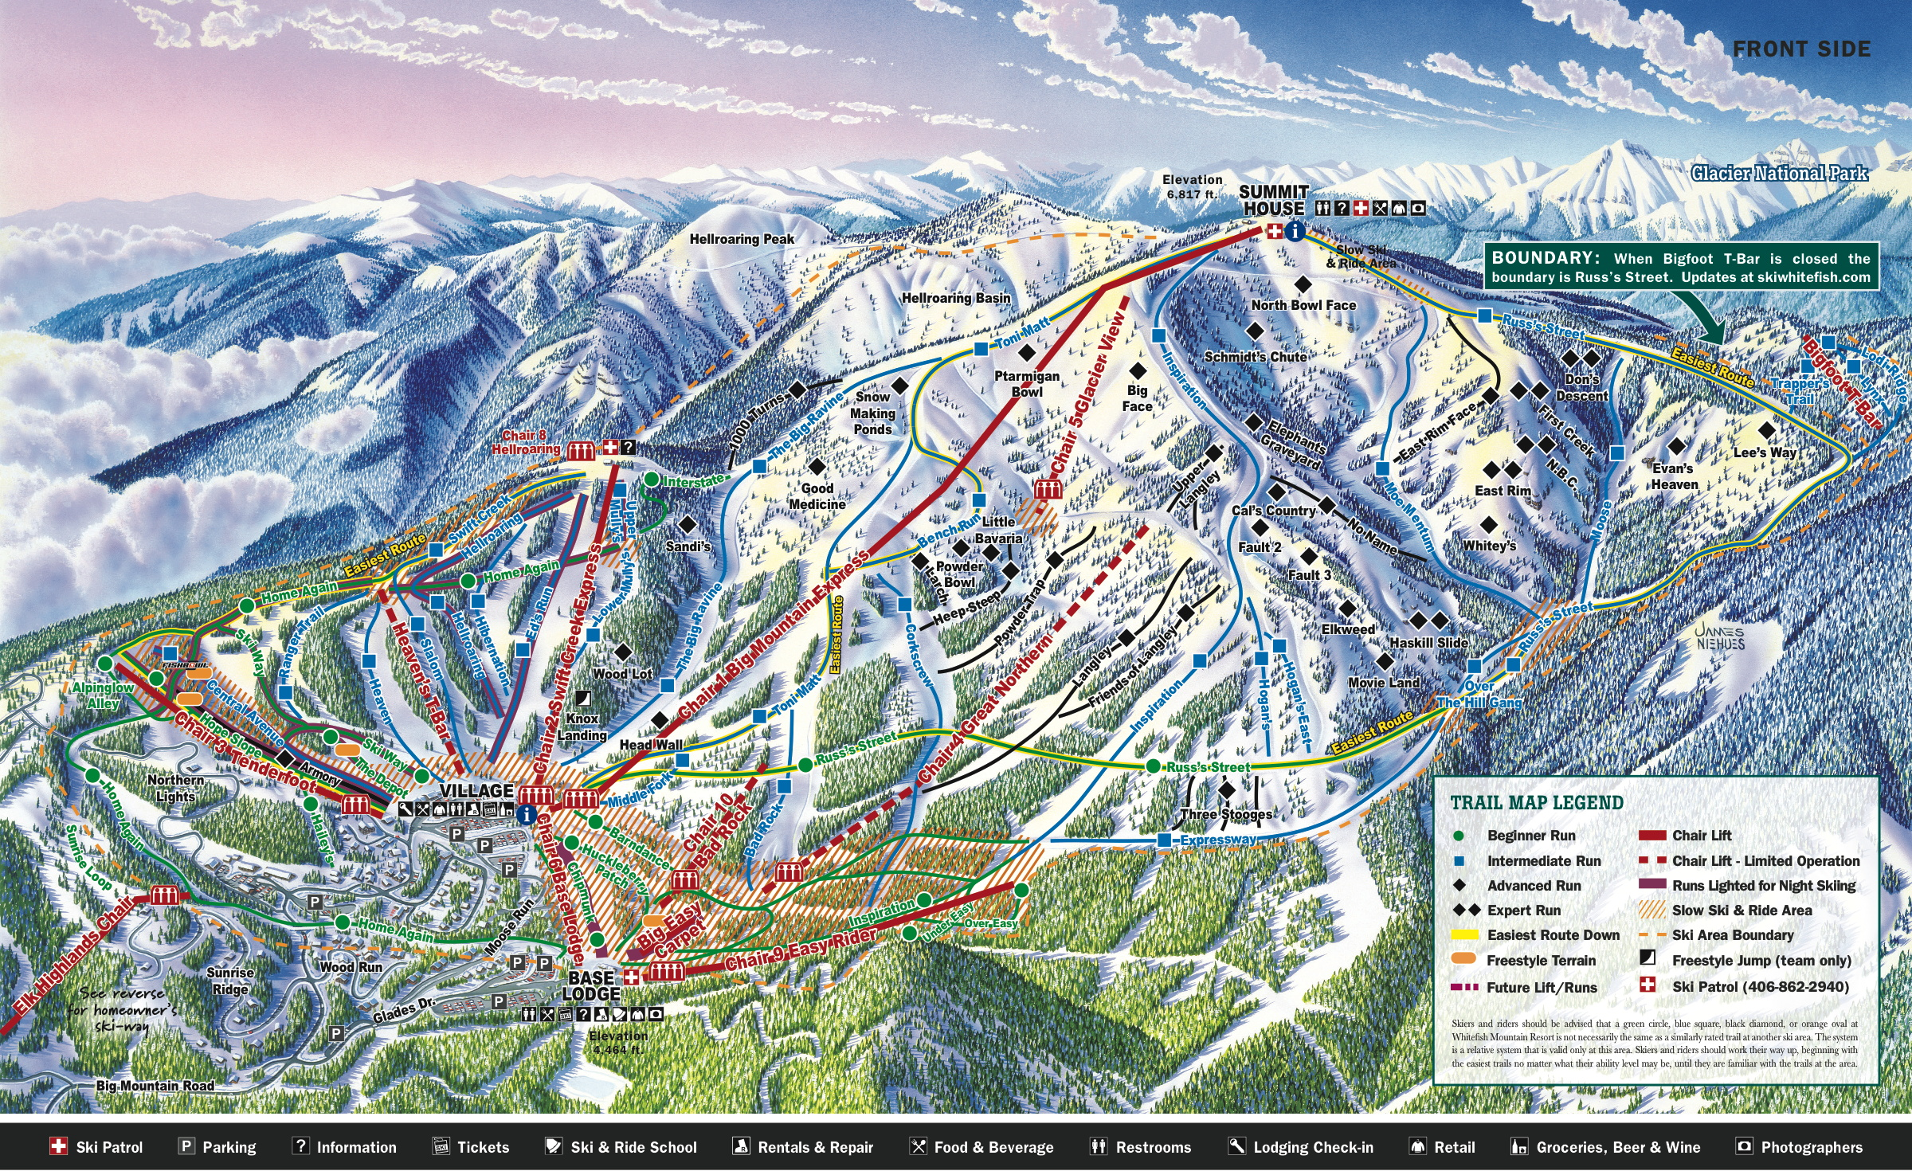
Big Mountain Resort Ticket Pricing Strategy
2022 Season
This Photo by Unknown Author is licensed under CC BY-SA-NC

Slide 2
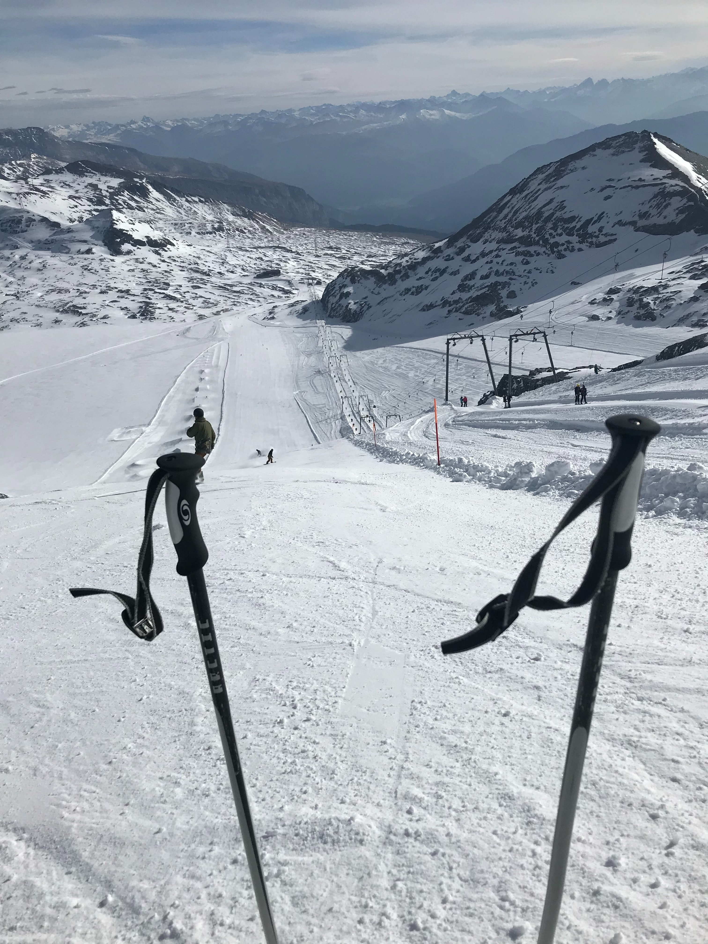
PROBLEM identification
Big Mountain Resort needs to determine if its current lift pricing strategy is in line when compared to both regional and industry trends. Analysis must be completed so any pricing changes can be reflected prior to upcoming seasonal market promotions.

Slide 3
PROBLEM identification
Context
Big Mountain Resort(“BMR”) has made an investment in chair lift capacity to improve skier accessibility will add $1.54 million to operating cost.
BMR perceives that it has superior facilities compared to its local competition. Wants to ensure that its pricing reflects the market price for superior facilities
Criteria for Success
Improve profitability by either reducing operating cost or raising ticket prices that the market will bare or both.
Provided an increase in value proposition for both customers and BMR.
Scope
Review similar markets to determine if capital investments are reflected as a distinct premium in lift pricing
Constraints
Stakeholder reluctance to change the status quo
Data Source
Feature information for 300 ski resorts form across the United States

Slide 4
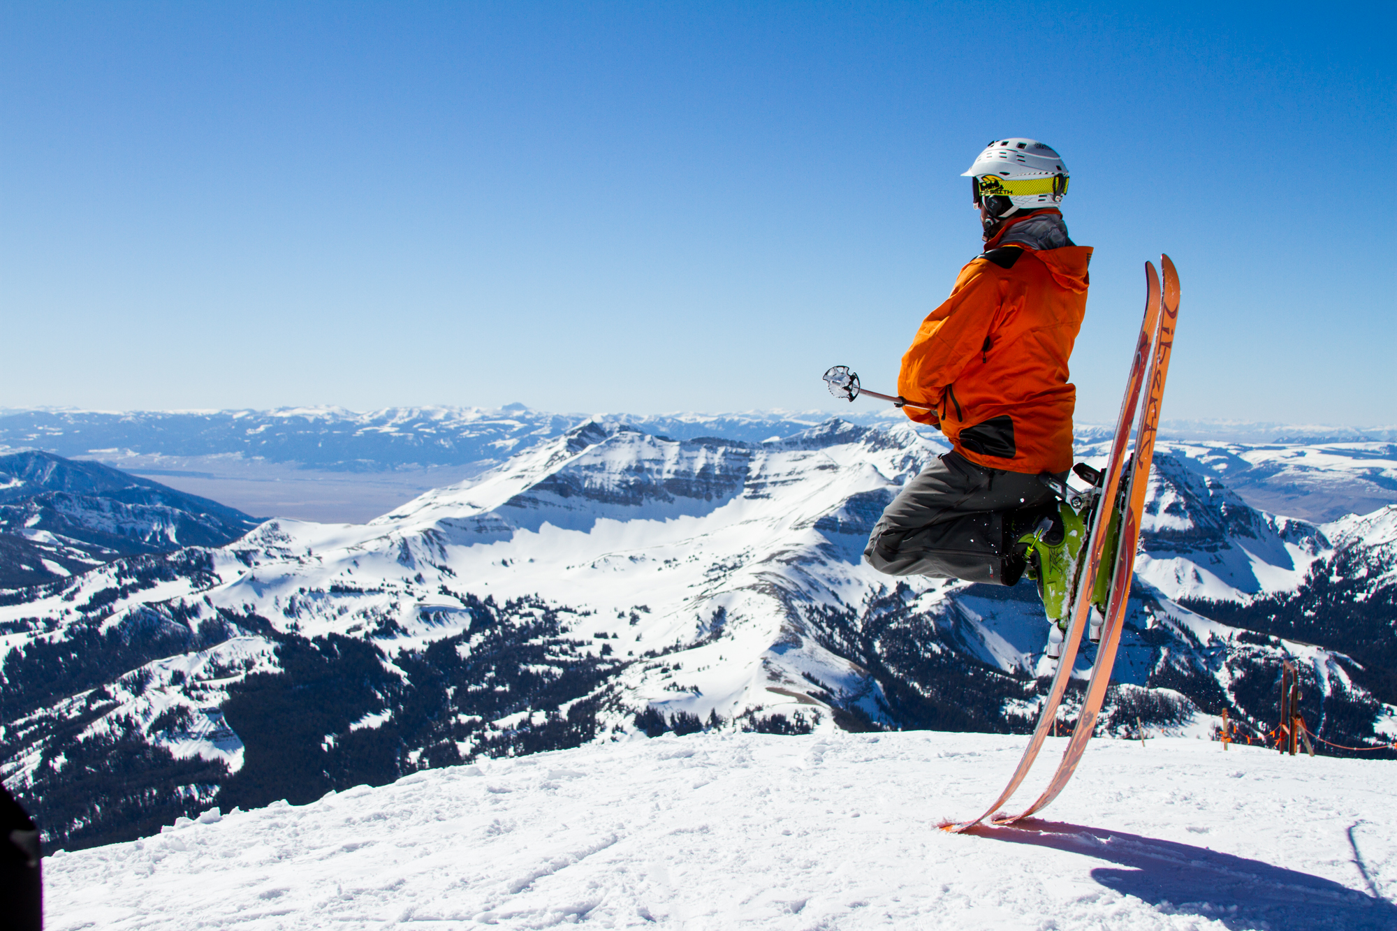
Recommendation and key findings
Important features for a ski resort
Vertical drop on slopes
Number of artificial snow acres
Total number of chairs
Number of FastQuads
Number of Runs
Longest run (miles)
Number of trams
Number of skiable acres
Key takeaways
The ability to quickly move customers to the runs via FastQuads appears to be linked to higher prices
The total chair ratios tend to support the idea of too much of a good thing (mobility) may lead to the commoditization of the offering.

Slide 5
Recommendation and key findings
Presently, BMR charges $81 for an adult weekend pass. The pricing model suggest a price of $95.87 with a Mean Absolute Error("MAE") of $10.39
As for covering the additional cost of the new chair lift, the cost per ticket would be approx. $0.88/ticket = ($1,540,000 operating cost/ (350,000 forecasted skiers * 5 tickets / forecasted skiers). The additional cost of the new chair lift would be covered by the ticket increase.
BMR’s current price is $14.87 ($95.87 -$81) below the projected model pricing. Current pricing is also outside of the bound for the MAE by $4.48 (14.87 - $10.39). On average, there appears to be plenty of room to opportunity to both increase profitability as well as cover the additional cost of the new chair lift.
Recommendation: Increase pricing to $96 per ticket

Slide 6
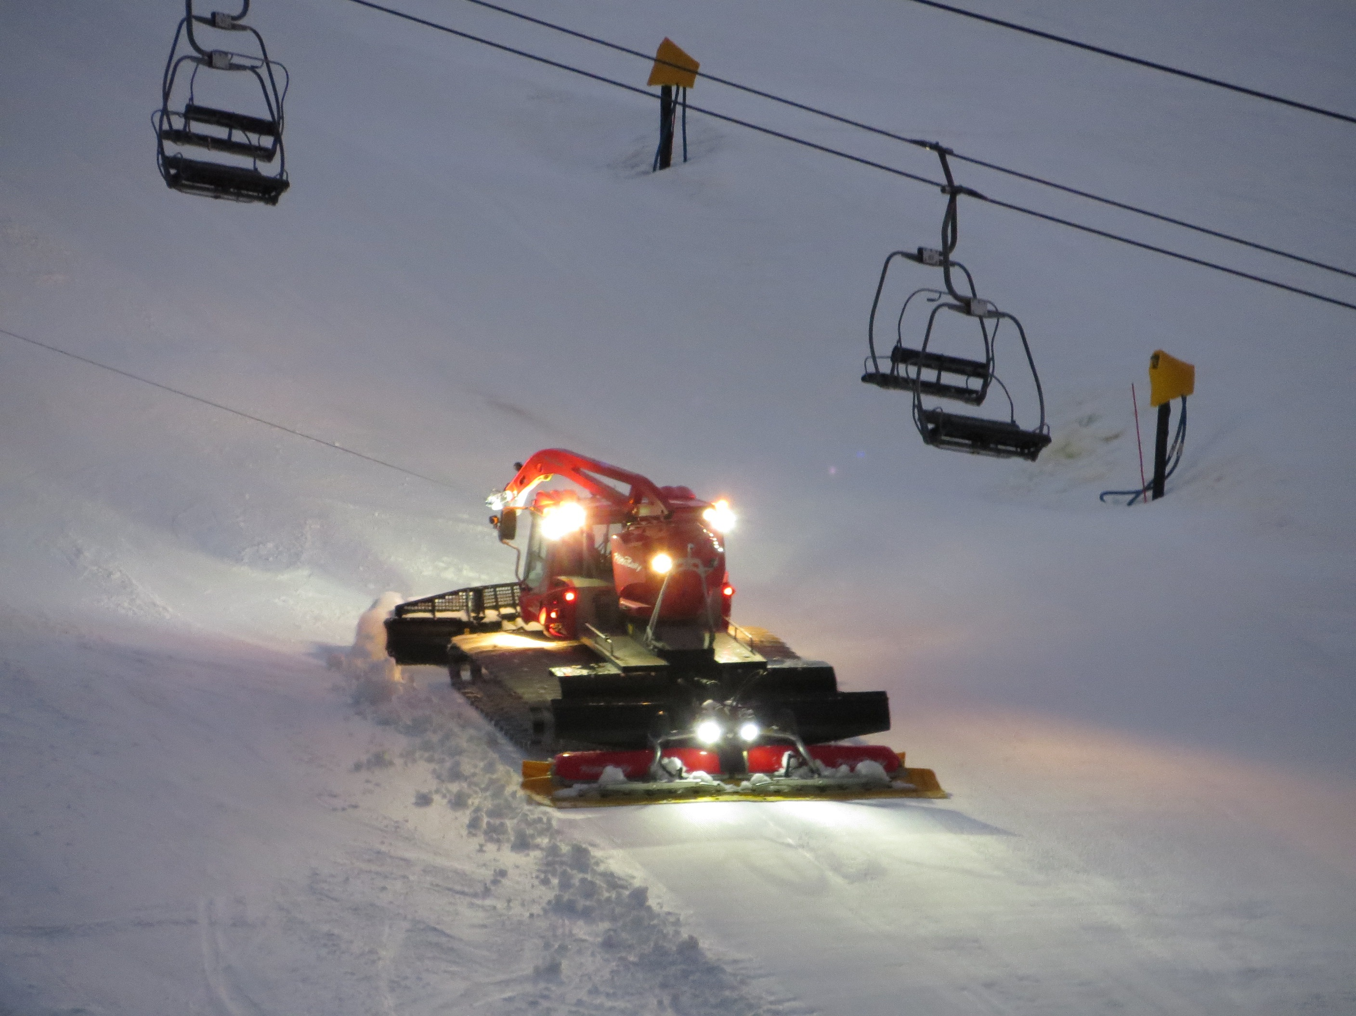
Modeling Results and Analysis
Model types used in the analysis
Average Price Model
Linear Regression Price Model
Random Forest Regression Model
Average Price Model
The mean ticket price of the 300 ski resorts provided is $63
The Mean Absolute Error ("MAE") of $19.
On average, guessing the price based on the mean would produce an estimate that would be approximately $19 off.
Linear Regression Price Model(“LR”)
Train MAE: 10.499032338015294 train standard dev: 1.6220608976799664
Test MAE: 11.793465668669324
Random Forest Regression Price Model (“RFR”)
Train MAE: 9.644639167595688 train standard dev: 1.3528565172191818
Test MAE: 9.537730050637332
Given the smaller difference between the Test MAE and Train MAE for the RFR as compared with LR model, used RFR for analysis.

Slide 7
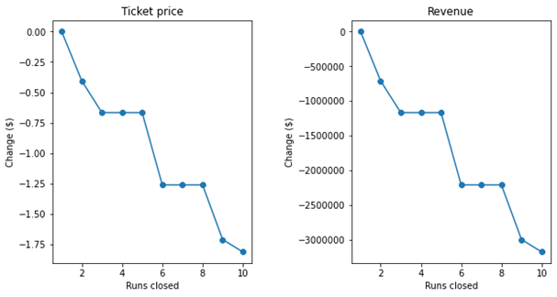
Modeling Results and Analysis
Scenario 1: Slope closure.
There are negative ticket price implications for the closure of slopes. This impact in per ticket price ranges from $0.00 for 1 slope closure to $1.75 for 10 slopes closures
Scenario 2: BMR adds a run, increases the vertical drop by 150 feet, and installs an additional chair lift.
This scenario increases support for ticket price by $1.99
Over the season, this could be expected to amount to $3,474,638 increase in ticket revenue.

Slide 8
Modeling Results and Analysis
Scenario 3: BMR adds a run, increases the vertical drop by 150 feet, installs an additional chair lift, and 2 acres of snow making
This scenario increases support for ticket price by $1.99
Over the season, this could be expected to amount to $3,474,638 increase in ticket revenue.
Snow making area does not enhance the revenue potential when added to Scenario 2.
Profitability is impacted due to cost incurred to create 2 acres of snow making
Scenario 4: BMR increases the longest run by .2 miles and guarantees its snow coverage by adding 4 acres of snow making capability
This scenario adds $0 to ticket price and $0 to increase revenue.
Scenario 4 improvements would decrease profitability due to the cost incurred without increase in ticket prices
RFR model weighted both lengthening ski run and increasing snow making capabilities as lower priorities to improving the ticket price.

Slide 9

Summary and Conclusion
Compared with the other scenarios, Scenario 2 is recommended as it will increase revenue and not have a negative impact on profitability.

